Slide 1

2026 Property Tax Update
Property Tax Division

Slide 2
Legislation – New Growth changes
2025 – SB 378
  Centrally Assessed New Growth will be calculated by industry
  7% Portion of the new growth goes to Species Protection Account
2026 – SB 206
  Project area new growth does not include Personal Property
  Definition of Real Property New Growth

Slide 3
Legislation – Tax Increase
2024
  SB 29 Tax Increase Process
2025
  SB 202 Property Tax Revisions
  SB 95 Truth in Taxation Amendments
2026
  HB 236 Truth in Taxation Amendments
  SB 238 Property Tax Adjustments

Slide 4

Property Tax Increase
“Truth in Taxation”
When you need more revenue than your Certified Tax Rate will generate.
59-2-919, 919.1, 919.2
59-2-924

Slide 5
Property Tax Rate Timeline
(Fiscal Year Entities)
  May 1st – June 13th Public Meetings**
  June 1st County Auditor and USTC
  June 8th Certified Tax Rate
  June 22nd Adopt proposed Tax Rate
  July 22nd Notice of Valuation
  Advertise for Tax Increase Hearing
  Hold Tax Increase Hearing on increase
  Before September 1st Adopt Final Tax Rate

Slide 6
Notify USTC and Auditor
Requires entity to notify County Auditor and Tax Commission by June 1st
  Date
  Time
  Location of proposed hearing
  County auditor will resolve any conflicts
    No overlapping hearings

Slide 7
Entity Advertisement
  Dollar amount of proposed tax increase revenue
  Entity’s public website
  Public comment and virtual participation
  No longer includes State Basic or Charter in % increase
  Still not included GO Bond in % increase
  No newspaper Ad
    Utah Legals still required
  No Virtual link
    Other instructions to find virtual link

Slide 8
Public Meetings
Separate agenda item
  taxing entity intends to state in the public meeting that the tentative budget includes a proposed tax rate increase
Make the Statement in the meeting
Present Property Tax Impact Statement

Slide 9
Property Tax Impact Statement
59-2-919(4)(b)(i)
The entity is considering a tax rate that exceeds the certified tax rate
The approximate dollar amount and purpose of the ad valorem tax revenue increase
The approximate percentage increase in ad valorem tax revenue based on the tax rate increase
That the entity shall provide notice of and conduct a public hearing as required where members of the public have an opportunity to comment on the proposed increase
For each department of the taxing entity whose budget would be affected
Outline the budget increase or decrease to the department
Articulate the operational impact to the department if the taxing entity approves the increase

Slide 10
Property Tax Impact Statement
Present and make available to the public
At each public hearing held prior to June 30 at which the taxing entity discusses the taxing entity's proposed general fund budget
Separate document from all other budget documents
Be included with County Notice of Valuation, if requested and paid for by the taxing entity.

Slide 11
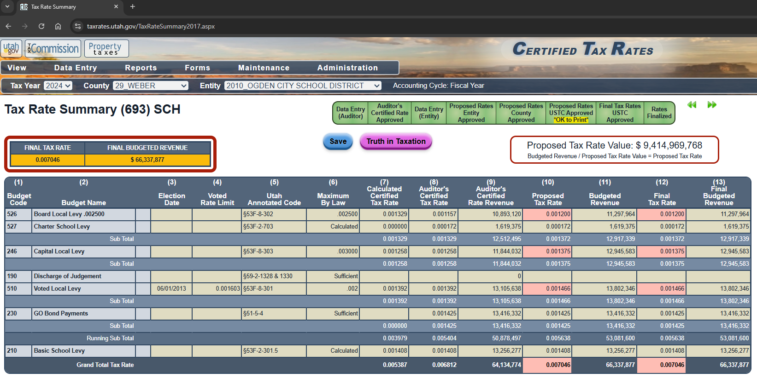
Adopt Proposed Tax Rate - 693

Slide 12
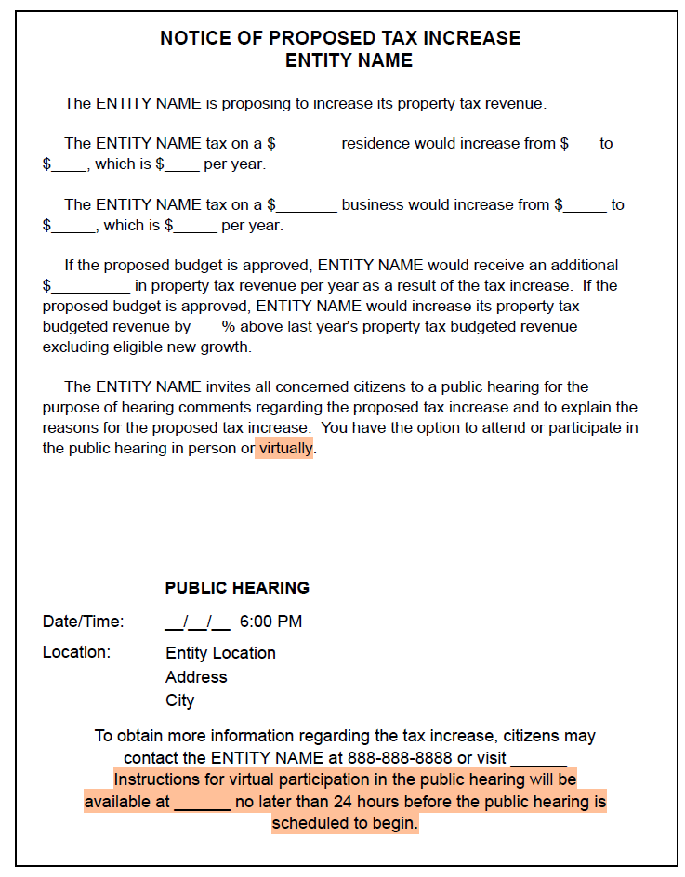
Entity Advertisement

Slide 13
Entity Advertisement
14+ days before the hearing
Utahlegals.com
Class A Notice
  Public Notice Website
  Entity’s website**
  Physical Location

Slide 14
County Combined Advertisement
59-2-919, 919.2
County
  At Least 2 weeks before any hearing
  Utah Legals
  Utah Public Notice
  County website
  Physical Location (Class A Notice)
  Provide to entity to have at hearing
Entity
  Entity’s Website Main Page
  Must be available at tax increase hearing and on request

Slide 15
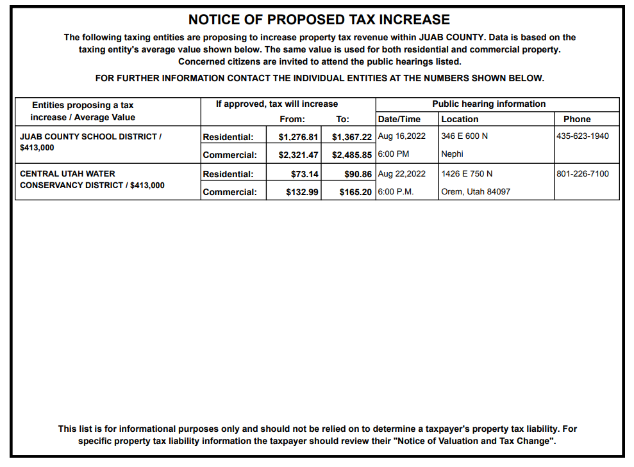
County Combined Advertisement example

Slide 16
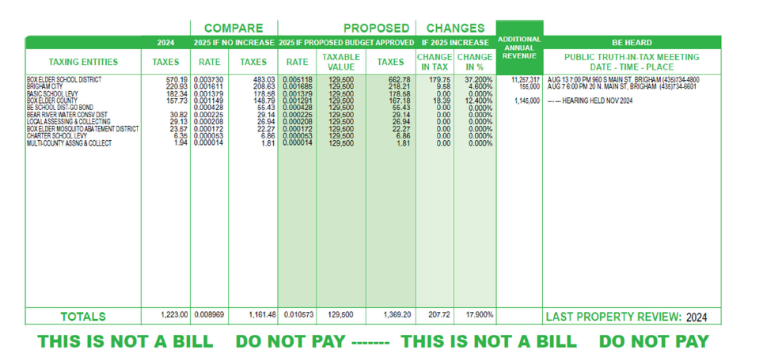
Notice of Valuation
59-2-919.1
Date, time, and location of public hearings
Dollar amount of tax difference, and % increase
Dollar amount of additional revenue to the entity
Breakout voted debt service and special purpose levies

Slide 17

Notice of Valuation
Sent out no later than July 22nd
Tax Increase Hearing must be at least 10+ days after Notice of Valuation is sent
Notice of Property Valuation
10 days

Slide 18
Virtual Participation
Post Instructions on Entity’s Website
  24+ hours before hearing
Entity needs to provide to participants
  Access to the public hearing through video and audio connections
  Provide opportunity for testimony through video, audio or both
  Allow written comments before and during the hearing

Slide 19
Public Hearing
No meetings discussing general business may be held on the same day as the property tax increase hearing
No overlapping hearings
6 PM or later
Requires that taxpayers are allowed to be heard with reasonable restrictions on time and without unreasonable restrictions on the number of people allowed to comment
The hearing must be open to the public and must be available for individuals to attend both in person or virtually

Slide 20
Public Hearing - Agenda
The property tax increase hearing agenda MAY NOT contain items on the agenda other than discussion and action on the taxing entity's intent to levy a tax rate that exceeds the taxing entity’s certified tax rate
The property tax increase hearing agenda MAY contain
  Discussion about the entity’s budget
  A special district’s fee implementation or increase
  A special service district’s fee implementation or increase
*The Entity Ad itself does not constitute an agenda.

Slide 21
Public Hearing - Statements
The dollar amount of additional ad valorem tax revenue that would be generated each year by the proposed increase
The purpose/reasons of the additional ad valorem tax revenue
Announce at the same property tax increase hearing the scheduled time and place of the next public meeting at which the taxing entity will consider the tax increase. Before September 1st

Slide 22
Evidence and Reporting
Resolution and/or “Form PT-800” explicitly stating the dollar amount of additional property tax revenue approved by the board
The entity must compile specific evidence that meets all property tax increase requirements, as listed above, and submit the evidence to the county auditor and the USTC for review
Within 7 days after adopting final budget

Slide 23
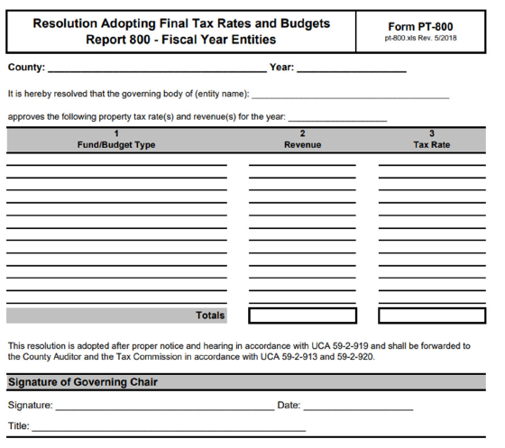
PT800 – Additional Revenue

Slide 24
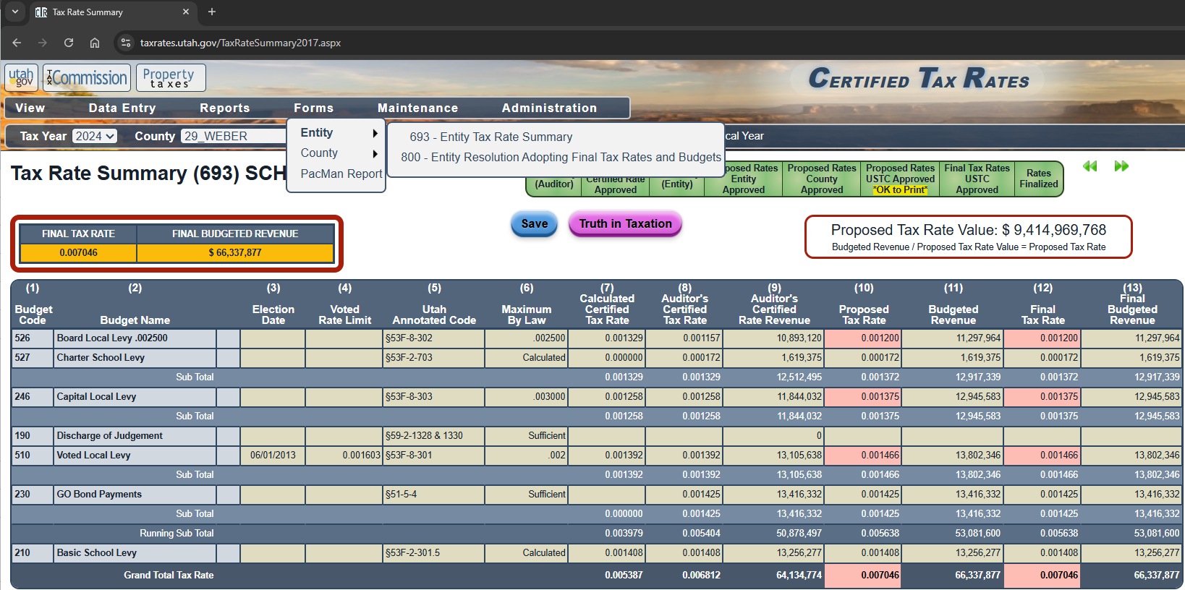
PT800 – Additional Revenue

Slide 25
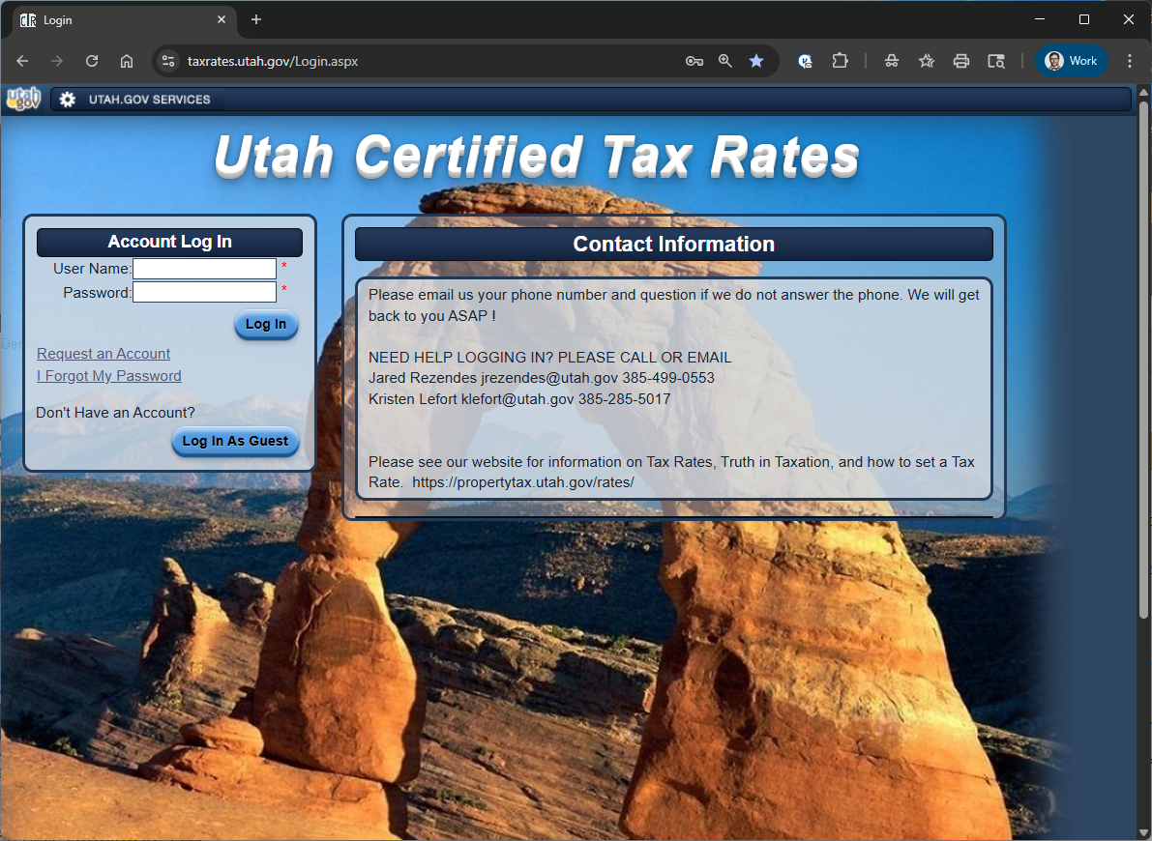
taxrates.utah.gov

Slide 26

Contact Us
Matt Hurst - matthewhurst@utah.gov
Jared Rezendes - jrezendes@utah.gov
Kristen Lefort – klefort@utah.gov
propertytax.utah.gov

