Slide 1
UGFOA ANNUAL CONFERENCE 2026
Grant Management
Best Practices:
A Playbook for Success
Jolena Ashman, Finance Director • High Valley Transit District

Slide 2
You’ve received a grant or grants. You need to administer a grants program. Now what??

Slide 3
SESSION OVERVIEW
10 Practical Tips for Local Government Finance Officers
01
Grant Setup & Roles
06
Accounting Software Settings
02
Grants in the Budget Process
07
SEFA Preparation
03
Fund Setup & GL Account Naming (ALN)
08
Reporting Essentials
04
Matching Revenue & Expenditures
09
Federal Operating Grant Practices
05
Grant Tracking Spreadsheets
10
Grant Closeout Procedures

Slide 4
01
Grant Setup &
Roles
Roles, forms, and compliance with 2 CFR Part 200

Slide 5
Standardized Forms & Grant Roles
01
📋 Standardized Intake Form
👤 Grant Roles & Responsibilities
ALN Number (Catalog of Federal Domestic Assistance)
Grant type: Federal / State / Local / Pass-through
State contract number (if applicable)
Reimbursement or pre-funded?
Award amount & period of performance
Reporting deadlines
Program administrator contact
Program Administrator
Manages scope, deliverables, and reporting
Finance/Accounting
Tracks expenditures, invoicing, draws
Grant Auditor / Reviewer
Verifies compliance with 2 CFR 200 Uniform Guidance
Executive Sponsor
Signs grant agreements, ensures accountability

Slide 6
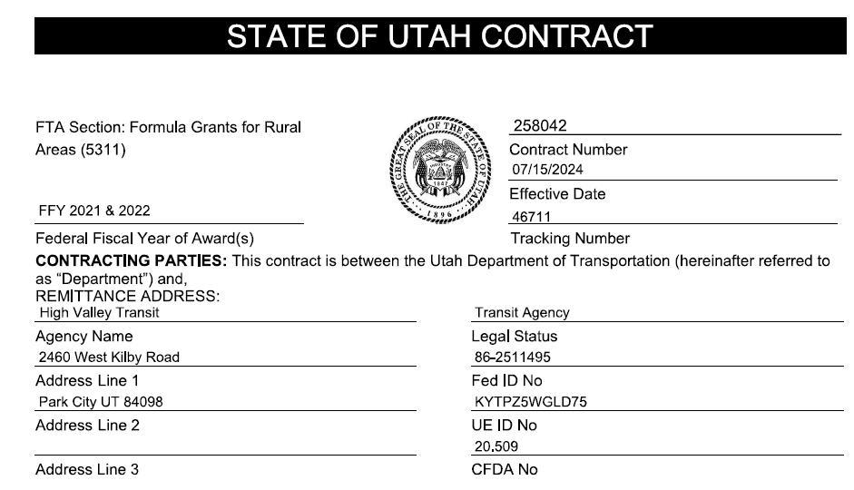
Grant Contract Information
01
The SEFA lists all federal awards expended during the fiscal year — required for single audit.

Slide 7
Compliance: 2 CFR Part 200 (Uniform Guidance)
01
Who must comply? Any entity that spends $750,000 or more in federal awards in a fiscal year.
Subrecipient Monitoring
Identify pass-through grants; monitor subrecipients for compliance
Allowable Costs
Costs must be allowable, allocable, and reasonable under the award
Internal Controls
Document controls over federal funds — written policies required
Single Audit
Required when federal expenditures exceed $750K; auditor tests grant compliance
Closeout
Liquidate obligations, submit final reports, return unused funds within 120 days

Slide 8
02
Grants in the Budget Process
Matching grant revenue to grant expenses

Slide 9
Grants in the Budget Process
02
Core Budgeting Principles
KEY CONCEPT
Grant revenue and grant expenditures must be budgeted together — they mirror each other
Depending on the size of your program, avoid appropriating grant funds in the general fund; use separate grant funds
Budget amendments should reflect actual award amounts, not estimates
Multi-year grants require multi-year budget perspective — plan for carryforward
Finance must coordinate with program staff during budget preparation to capture all grant activity
Grants that come in after the budget is set may trigger a budget amendment
Grant revenue
=
Grant expenses
Grants should never
create a net surplus
or deficit in the fund.

Slide 10
03
Fund Setup &
GL Account Naming
Special revenue funds and using ALN numbers

Slide 11
Setting Up Special Revenue Grant Funds
03
Why use separate special revenue funds for grants?
Reduces Budget Churn
Cleaner Audit Trail
Grants don't cycle through the general fund, avoiding unnecessary budget amendments
Grant activity is isolated — easier for auditors to test and trace
Simplifies Reporting
Prevents Cross-Contamination
Run fund-level reports for grant status without filtering from a mixed fund
Prevents inadvertent commingling of grant and non-grant funds

Slide 12
GL Account Naming: Use ALN Numbers
03
What is an ALN Number?
The Assistance Listings Number (ALN) — formerly CFDA — uniquely identifies every federal grant program. Embedding it in your GL account names creates an automatic link to your SEFA.
EXAMPLE GL ACCOUNT NAMING CONVENTION
3325-000-000: FTA 5311 Grants – 20.509
Dept Code
ALN #
Agency + Description + Year
✓ Search account by ALN to instantly find all related grant lines
✓ Same ALN used on SEFA — direct tie from GL to schedule

Slide 13
04
Matching Revenue &
Expenditures
Recognizing grant activity appropriately

Slide 14
Revenue & Expenditure Recognition
04
Reimbursement Grants
Pre-Funded / Advance Payment Grants
Spend first, claim reimbursement after
Record expenditures as incurred
Revenue recognized when reimbursement request is submitted and eligible
No revenue until the expense is incurred and claim is submitted
Example: FTA Section 5311 operating grants
Pros: Parameters are set and clear
Cons: Constrains cash balances
Receive funds upfront before spending
Funds received = Unearned Revenue (liability)
Revenue recognized as expenses are incurred
Unearned revenue balance decreases as funds are spent
Example: Some CDBG and formula grants, state TTIF grants, COVID funding
Pros: money in hand
Cons: Scheduled payments may not match rate of spending

Slide 15
05
Grant Tracking Spreadsheets
Keep it simple, keep it current

Slide 16
Grant Tracking Spreadsheet: Key Elements
05
One master spreadsheet per grant — or a portfolio tracker for all active grants:
Field | Why It Matters
Grant Name & ALN # | Links to GL and SEFA immediately
Award Amount | Baseline for budget monitoring
Expenditures to Date | Running total from accounting system
Remaining Balance | Award minus expenditures — critical for closeout
Reimbursement Requested | Track draws submitted vs. received
Match Required / Provided | Ensure local match obligations are met
Report Due Dates | Never miss a deadline
Period of Performance | Know when the grant expires
Grant Contact (Program Officer) | Quick reference for questions

Slide 17
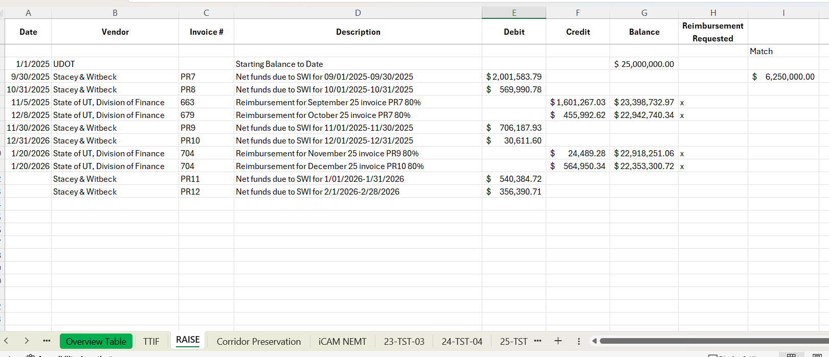
Grant Tracking Spreadsheet: Key Elements
05
One master spreadsheet per grant — or a portfolio tracker for all active grants:

Slide 18
06
Accounting Software
Settings
Using grant activities and modules effectively

Slide 19
Accounting Software: Grant Tracking Setup
06
Use your accounting software's native grant/project tracking features — don't rely solely on spreadsheets:
Set Up Grants as Activities / Projects
Budget by Activity
Most government accounting systems (Tyler Munis, Caselle, Pelorus, etc.) support project or activity codes — use one per grant
Enter the grant award as the budget on the activity — auto-alerts when approaching limits
Assign a Grant Start/End Date
Use Encumbrance Tracking
System can flag expenditures outside the period of performance
Encumber purchase orders against the grant before the invoice arrives — prevents over-commitment
Revenue Account by Grant Activity
Run Standard Grant Reports Regularly
Match revenue accounts to the same activity code as expenses for clean fund-level reporting
Budget vs. actual by grant, expenditure detail, draw history — set a monthly review routine

Slide 20
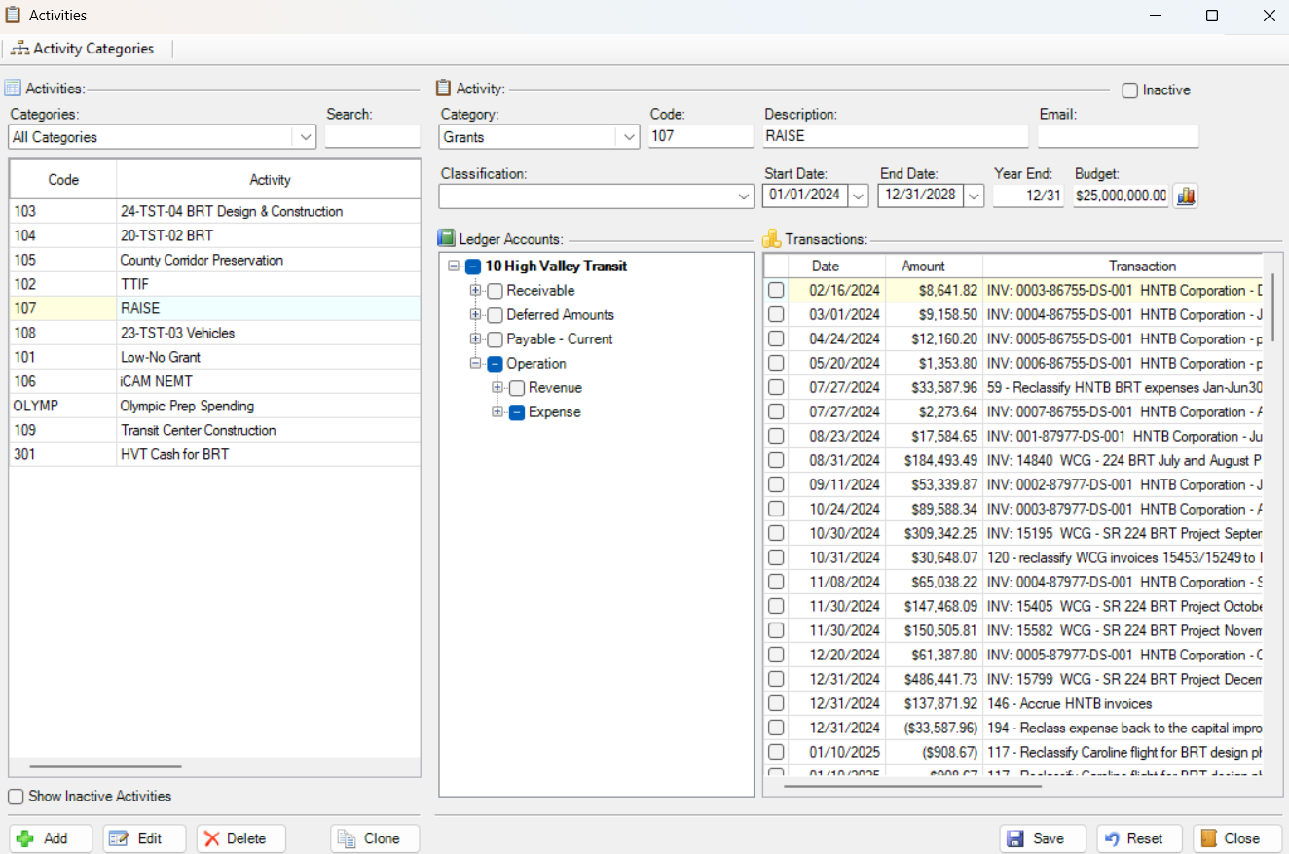
Accounting Software: Activities
06

Slide 21
07
SEFA Preparation
Schedule of Expenditures of Federal Awards

Slide 22
How to Prepare the SEFA
07
The SEFA lists all federal awards expended during the fiscal year — required for single audit.
1
Identify all federal expenditures
Pull from GL using ALN numbers — this is why naming matters
2
Classify by federal program
Group by ALN / program name, not by fund or department
3
Distinguish direct vs. pass-through
Pass-through grants need grantor name and award ID
4
Reconcile to GL
SEFA total must tie to federal revenue recorded in the financial statements

Slide 23
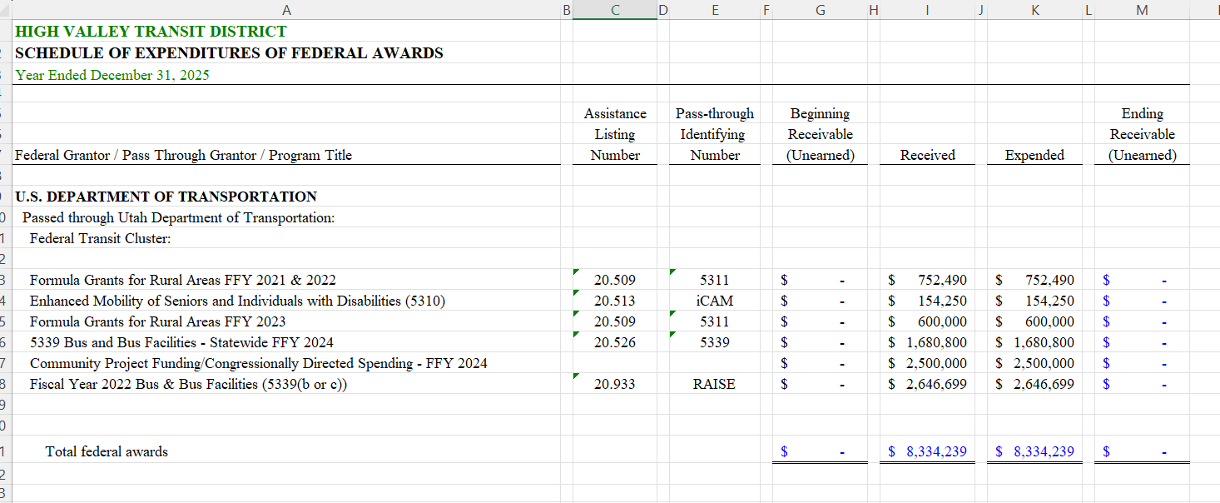
How to Prepare the SEFA
07

Slide 24
08
Grant Reporting
Essentials
What grantors want — and how to deliver it

Slide 25
Grant Reporting: What Every Grantor Expects
08
Qualitative Reporting
Quantitative / Financial Reporting
Narrative progress toward grant goals and milestones
Descriptions of services provided, populations served
Challenges encountered and corrective actions taken
Partnerships and coordination activities
Stories or case studies (for some community grants)
Invoices — itemized backup for all claimed expenses
Remittance documentation — proof of payment
Summary expenditure report — budget vs. actual
Match documentation — in-kind or cash contributions
Cumulative draw summary — total requested to date

Slide 26
09
Federal Operating
Grant Practices
Tips specific to operating (non-capital) federal grants

Slide 27
Federal Operating Grants: Key Practices
09
Track Indirect Costs Carefully
Time & Activity Records
Apply your approved indirect cost rate (or de minimis 10%) consistently; document the methodology
Employees charged to federal grants need documented time records — even for salaried staff
Procurement Standards
Cash Management
Follow federal procurement requirements (2 CFR 200.317-326) for purchases charged to the grant
Minimize time between drawing funds and disbursing — avoid excess cash on hand per 200.305
Subrecipient vs. Contractor
Period of Performance
Correctly classify sub-awards; subrecipients require pass-through monitoring
Expenditures must occur within the authorized period — pre-award costs need prior approval

Slide 28
10
Grant Closeout
Procedures
Ending a grant the right way

Slide 29
Grant Closeout: Checklist
10
Don't let grants linger — a clean closeout protects your organization and frees up administrative capacity.
Grant Period Confirmed
Know the official end date — no expenditures after this date without prior approval
All Funds Expended
Review budget vs. actual — request no-cost extension if needed before deadline
Final Reports Submitted
Financial and programmatic reports submitted within required timeframe (often 90-120 days)
Unused Funds Returned
Refund unspent federal funds promptly; document the return
Renewable Grant?
If renewal is possible, begin application process before current period ends
GL Accounts Closed
Inactivate grant activity codes; prevent further posting after closeout
Records Retained
Retain grant records per 2 CFR 200.334 (generally 3 years from final expenditure report)

Slide 30
Questions?
Budget & Fund Setup • Tracking & GL Naming • SEFA & Revenue Recognition • Admin & CFR 200 • Software & Reporting • Closeout Procedures

