Slide 1

Sales Tax Updates
Presented by Cai-Peng Guan and Alexis Huhtala

Slide 2


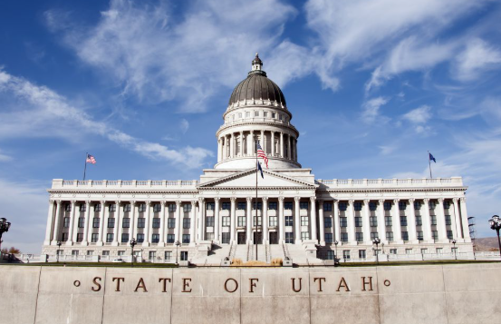
Topics

Slide 3
Distribution Updates

Slide 4
Liquor Tax
First distribution processed in March
Second distribution coming

Slide 5
Population
Updated estimates from UPC available in July
Respond to the surveys

Slide 6
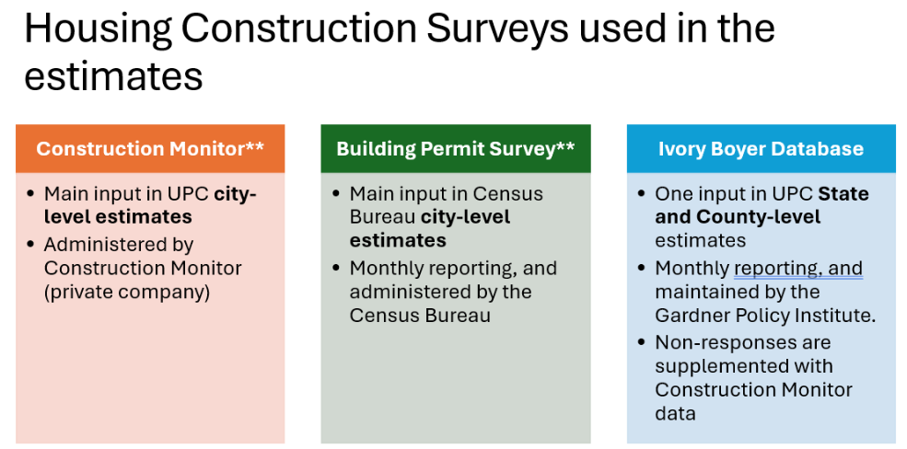
Population

Slide 7
Adjustments
Homeless shelter mitigation: Each January
Sand and gravel sales tax: Each July
Admin fee: January 2026

Slide 8
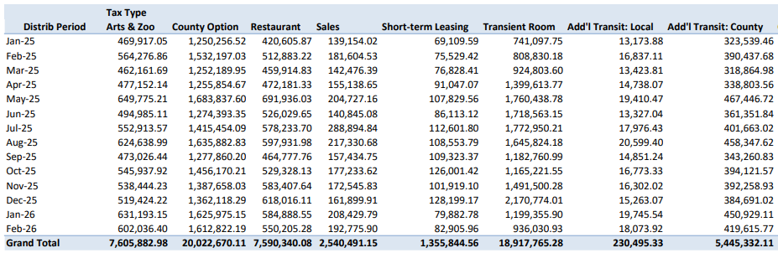
Reports
Audit confirmation reports

Slide 9
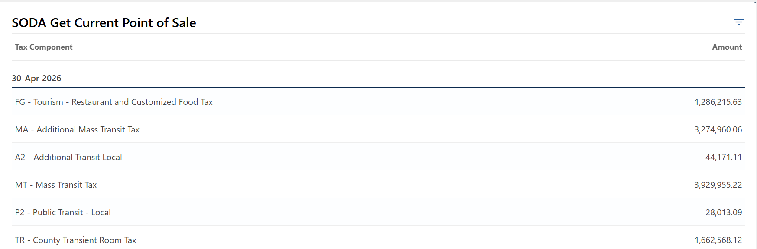
Reports
View current point of sale
Does NOT account for population and other adjustments

Slide 10
Special Entities and Sales Tax
Military Installation Development Authority (MIDA)
Utah Inland Port Authority (UIPA)
Utah Lake Authority (ULA)
Utah Fairpark Area Investment and Restoration District (UFAIR)
Point of the Mountain State Land Authority (POMSLA)
Housing and Transit Reinvestment Zone (HTRZ)
……and more

Slide 11
Special Entities and Sales Tax
Special entities may impose and receive distribution of certain taxes:
  Resort Communities Tax
  Accommodations Tax
  Municipal Energy or Telecom Tax
Taxes imposed by underlying jurisdictions within special entities project areas will go to the underlying jurisdictions

Slide 12
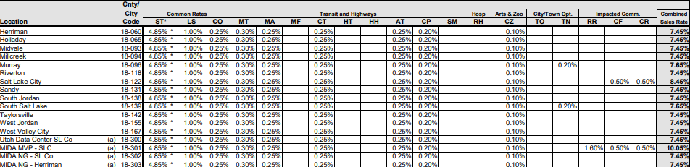
Special Entities and Sales Tax
All these taxes are redirected back to the underlying jurisdictions.

Slide 13
Special Entities and Sales Tax
Special entities are allowed to collect sales tax from businesses physically located within their boundaries
Not administratively feasible to accurately source online sales to special entity locations

Slide 14
Sales Tax Increment
What is an Increment?
  A percentage of tax collected in excess of the amount collected in the base year
What is a Base year (amount)?
  The amount of tax revenue collected from businesses physically located in the boundaries of an increment imposing location within the first year of its creation
  Base years do not change!

Slide 15
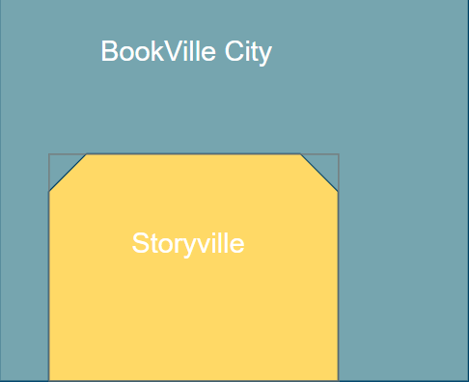
Sales Tax Increment: Example
BookVille City is a municipality
On 01/01/2023, Storyville, located within BookVille City, was created as a special entity project area and got its own sales tax location code.

Slide 16
Sales Tax Increment: Example
In the base year 2023, $900,000 was collected in BookVille City. $200,000 out of that amount was collected from businesses located within Storyville boundary
$260,000 was collected within Storyville boundary in 2024
Increment % is 15%

Slide 17
Sales Tax Increment: Example
How much should BookVille City and Storyville receive respectively in 2023?
  BookVille City: $900,000
  Storyville: $0

Slide 18
Sales Tax Increment: Example
How much should BookVille City and Storyville receive respectively in 2024?
  BookVille City: $251,000 $200,000 + $60,000 * 85% = $251,000
  Storyville: $9,000 ($260,000 - $200,000) * 15% = $9,000

Slide 19
Revenue Updates

Slide 20
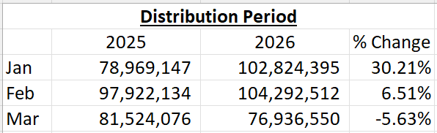
Volatility and Timing of Payment

Slide 21
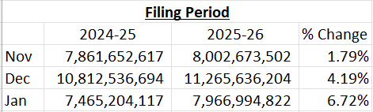
Volatility and Timing of Payment

Slide 22
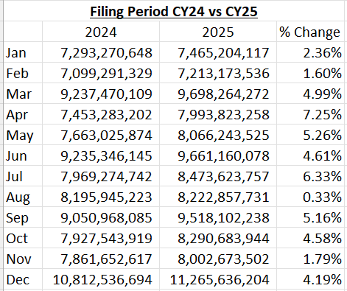
Volatility and Timing of Payment

Slide 23
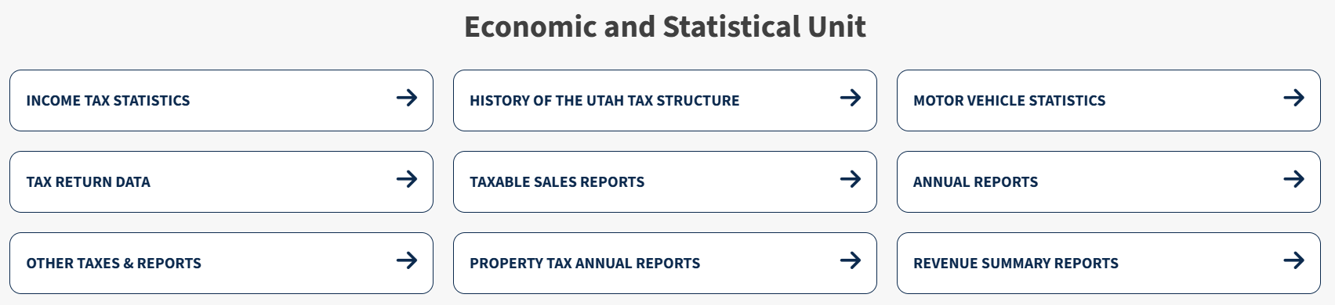
Sales Tax Return Data
Economic and Statistical Unit

Slide 24
Website Updates

Slide 25
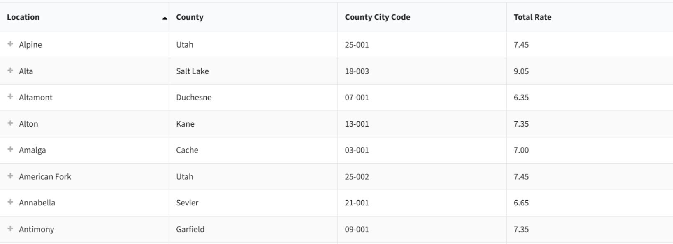
Website Updates
Need to meet Web Content Accessibility Guideline (WCAG) standards
Save your reports
Updated rate search table

Slide 26
Legislative Updates

Slide 27
HB308 Homeless Service Amendments
This bill:
amends the duties of the Office of Homeless Services (office) and duties of the homeless services coordinator (coordinator)
permits a service provider to temporarily expand a congregate shelter's bed capacity limit under certain conditions
changes provisions related to a participating local government's tax revenue distributions for homeless shelters

Slide 28
HB308 Homeless Service Amendments
Sales tax impact: Increase CY 2027 homeless shelter deductions amount
59-12-205(5)(a)(i)(A) “the lesser of $316,250 or an amount equal to 2.93%...”

Slide 29
HB425 Local Government Fees Amendments
This bill:
prohibits a city from imposing a fee on the general public for broadband or public safety service, with exceptions
prohibits a town from imposing a fee on the general public for public safety services, with exceptions
authorizes a municipality or a county to impose a transportation utility fee
establishes the process and requirements for a municipality or county to impose or increase a transportation utility fee
establishes the process and requirements for a municipality or county to use the revenue generated by a transportation utility fee
requires a municipality or county that establishes a transportation utility fee to:
  establish an appeal process; and
  conduct an annual review of the fee;
provides that an ordinance imposing a transportation utility fee is subject to local referenda

Slide 30
HB425 Local Government Fees Amendments
Will not impact ability to impose Municipal Telecom Tax

Slide 31
HB457 Municipal Annexation Amendments
This bill:
requires certain unincorporated islands in a county of the second class to automatically annex into a bordering municipality
requires a county of the second class to provide notice of an automatic annexation
permits certain local legislative bodies to exempt unincorporated islands from automatic annexation
permits a final local entity plat for an annexation to depict non-contiguous areas
modifies the authority of a county operating under the council-manager form of government to delegate accounting services

Slide 32
HB457 Municipal Annexation Amendments
Please notify our group of your annexations to receive sales tax
Send all notices to salestaxdist@utah.gov

Slide 33
HB481 Transportation Modifications
This bill:
provides flexibility in distribution frequency of class B and class C road funding
directs local corridor preservation funds to go directly to the relevant local government instead of passing through the Transportation Fund
modifies certain uses for local corridor preservation funds

Slide 34
HB481 Transportation Modifications
Certain jurisdictions will start receiving distributions directly through USTC instead of passing through UDOT

Slide 35
HB507 State Coordination of Regional and Local Economic Development Projects Amendments
This bill:
prohibits a political subdivision from providing an incentive to a large load data center, with exceptions;
establishes the State Reinvestment Restricted Account (account);
describes the potential uses for money in the account;
directs the Utah Inland Port Authority to deposit certain revenues into the account;
modifies certain requirements for a public infrastructure district;
creates the optional County Energy Excise Tax;
requires the State Tax Commission to deposit revenue, in certain circumstances, into the account;
provides that a housing and transit reinvestment zone, first home investment zone, convention center reinvestment zone, or home ownership promotion zone may not be created after January 1, 2028;
provides retrospective operation for certain provisions governing a housing and transit reinvestment zone, first home investment zone, and convention center reinvestment zone to May 4, 2022;
creates a process for a county or city to propose a regionally significant development zone (zone) and for a committee to approve the creation of a zone;
authorizes a zone to capture and utilize certain forms of tax increment;
modifies the prohibition on local government offering a financial incentive for an energy development project outside an electrical energy development zone;

Slide 36
HB537 Host Committee Sales of Olympic Products
This bill creates a new sales and use tax exemption for tickets to the 2034 Olympic and Paralympic Winter Games.
New Sales Tax Exemption:
  Amends Section 59-12-104 to add a sales and use tax exemption for the sale of an "Olympic or Paralympic ticket" .
  Defines "Olympic or Paralympic ticket" to include:
    A ticket to an Olympic or Paralympic event or venue for the 2034 Games.
    A hospitality package that bundles a ticket with exclusive amenities, food, beverages, merchandise, or other hospitality offerings

Slide 37
SB162 Online Sales Tax Amendments
This bill modifies sales and use tax provisions for online transactions by expanding sales and use tax to include digital works and gaming services and creating an exemption for multi-channel video services.
New sales and use tax on digital works and services
  Imposes sales and use tax on amounts paid or charged for access, including streaming of or by subscription, to:
    digital audio-visual works;
    digital audio works;
    digital books; and
    gaming services.
  Specifies that the tax applies regardless of:
    the delivery method of the digital work or service; or
    whether access is provided as a single-use purchase or through a subscription, even if the right terminates upon the occurrence of a condition.
New sales and use tax on prewritten computer software
  Defines seller-hosted prewritten computer software as software accessed through the internet or a seller-hosted server, regardless of whether access is permanent or if any downloading occurs.
  Imposes sales and use tax on amounts paid or charged for:
    prewritten computer software delivered either electronically or by load and leave; or
    seller-hosted prewritten computer software.
New sales and use tax exemption for multi-channel video
  Provides a sales and use tax exemption for amounts paid or charged for a transaction subject to a tax under Chapter 26, Multi-Channel Video or Audio Service Tax Act.

Slide 38
SB217 Local Food Amendments
This bill addresses provisions related to locally-produced foods and creates a new sales tax exemption for home cooks.
New sales tax exemption for food prepared by a home cook
  Defines home cook as an individual who prepares food and food ingredients or prepared food exclusively in a private, noncommercial home kitchen.
Creates a new state sales and use tax exemption for the sale of food and food ingredients or prepared food by a home cook.

Slide 39
Q & A

Slide 40
Thank You!
salestaxdist@utah.gov
(801) 297-3836

