Slide 1


Utah Government Finance Officers Association

Slide 2
962 total bills drafted
568 House Bills
342 Senate Bill
52 Resolutions
582 bills passed
ULCT tracked 279 bills that directly impact municipal governments

Slide 3
Administration

Slide 4
HB 64 Public Official Bonding Amendments
Administration
HB 64
HB 65
HB 109
HB 139
HB 295
HB 475
HB 552
SB 165
J. Dunnigan
Repeals requirement for public officials to have a bond and replaces it with a requirement to have crime insurance.
Council sets the amount of crime insurance required for each municipal officer (mayor, councilmembers, treasurer, and others designated by the municipality).
Local government is responsible for paying premiums.

Slide 5
HB 65 Firefighter Cancer Amendments
Administration
HB 64
HB 65
HB 109
HB 139
HB 295
HB 475
HB 552
SB 165
C. Snider
Modifies the existing presumption that certain cancers are service-related for firefighters.
  Expands list of cancer types
  Maintains rebuttable presumption standard
  Adds additional parameters (e.g., a requirement to demonstrate exposure to carcinogens)
  Requires regular screenings for eligibility
  Consideration for tobacco/marijuana use.
Legislature funded 3 years of screenings; agencies will need to fund screenings beginning Jan 1, 2029.
Uncertain fiscal impact on workers comp/insurance premiums.

Slide 6
HB 109 Municipal Election Amendments
Administration
HB 64
HB 65
HB 109
HB 139
HB 295
HB 475
HB 552
SB 165
N. Abbott
Prevents a municipal council from adopting a more restrictive procedure for dismissing a city manager between:
the date that a municipal general election is held and
the date that the recently elected councilmembers take office.

Slide 7
HB 139 Government Accounting Amendments
Administration
HB 64
HB 65
HB 109
HB 139
HB 295
HB 475
HB 552
SB 165
A. Loubet
Requires state auditor to develop a financial certification form in consultation with local government stakeholders
Requires municipal chief administrative officer and chief financial officer to include certification form in annual financial reports.

Slide 8
HB 295 Municipal Fees and Political Subdivisions Lien Amendments
Administration
HB 64
HB 65
HB 109
HB 139
HB 295
HB 475
HB 552
SB 165
P. Cutler
Did not pass
Would have authorized municipalities to hold liens on properties for past-due water, sewer, or utility-related fees.
Would only apply to utility-related services provided by municipalities that set fees by ordinance that bill customers through a third-party service provider.
  E.g., municipalities that without utilities that could be readily turned off for non-payment.

Slide 9
HB 475 Public Funds Reporting Amendments
Administration
HB 64
HB 65
HB 109
HB 139
HB 295
HB 475
HB 552
SB 165
N. Walter
Requires state auditor to annually report total balances, cash, cash equivalents, and investments for each entity that holds public funds.

Slide 10
HB 552 Local Building Authority Amendments
Administration
HB 64
HB 65
HB 109
HB 139
HB 295
HB 475
HB 552
SB 165
T. Auxier
Did not pass
Would have prohibited a local building authority from constructing, acquiring, improving, extending, or financing a project on behalf of a local government if the project (or a similar project) was rejected by voters.

Slide 11
SB 165 Municipal Broadband Service Amendments
Administration
HB 64
HB 65
HB 109
HB 139
HB 295
HB 475
HB 552
SB 165
L. Fillmore
Subjects municipal broadband service to requirements in the Municipal Cable Television and Public Telecommunications Services Act.
  Creates significant public process requirements for NEW municipal broadband systems
  Cities with existing broadband services are grandfathered.

Slide 12
Taxes

Slide 13
HB 456 Transient Room Tax Amendments
Taxes
HB 456
HB 511
SB 16
SB 37
SB 67
SB 295
B. Bolinder
Clarifies county TRT uses & reporting
Increases state TRT rate from 0.32% to 1.07% (1.32% in Salt Lake County).
  33% of new money dedicated into Outdoor Recreation Mitigation Grant Fund. Remainder flows into State General Fund.
  The additional .25% in Salt Lake County is deposited into a specific fund.
If ≥50% of a county’s TRT is generated with the boundaries of a municipality, the county shall include a representative from that county on their tourism advisory board.

Slide 14
HB 511 Property Tax Ballot Question
Taxes
HB 456
HB 511
SB 16
SB 37
SB 67
SB 295
T. Auxier
Did not pass
Would have required non-binding opinion question approval for increasing property taxes; waived Truth in Taxation requirements
Capped new growth at lesser of eligible new growth or inflation-adjusted budget increase.
Expect more interim conversations on property tax!

Slide 15
SB 16 Property Tax Notice Amendments
Taxes
HB 456
HB 511
SB 16
SB 37
SB 67
SB 295
L. Fillmore
Extends property tax deferral to indigent individuals.
  Undefined, judicial code sets indigency at ≤150% federal poverty or the individual has insufficient means of paying for representation without depriving individual or their family of food, shelter, clothing, or other necessities.
Requires county auditors to include property tax deferral program eligibility information in tax valuation notices.
  Information must specifically state, “If you are 65 years or older, disabled, or experiencing extreme hardship, ad this is your primary residence, you may be eligible to defer payment of this property tax.”
  Must include a telephone number or website with a telephone number that a property owner may find additional information about applying for deferral.
Notes:
Utah 1 person HH=$15,650; 2 person HH=21,150; 3 person HH = $26,650, etc.

Slide 16
SB 37 Minimum Basic Tax Rate Amendments
Taxes
HB 456
HB 511
SB 16
SB 37
SB 67
SB 295
L. Fillmore
Passed, vetoed
Would have set a minimum school funding amount ($4,494 per student in FY 25) for each district.
School district property tax dollars would be diverted to State General Fund.
School districts would then receive minimum school funding amounts from income tax fund in the same amount.
Notes:
State would have swapped GF $ with earmarked income tax $.
When it comes to trust, nothing is more critical or sacred than the way we handle taxpayer dollars. After receiving veto requests from the State Auditor, State Board of Education, the Utah School Boards Association, and the Utah School Superintendents Association, I have decided to veto Senate Bill 37, Minimum Basic Tax Rate Amendments. At its core, this bill changes how we collect and distribute the state portion of property tax revenues for schools. Right now, Utahns are correctly told by their government that their local property tax dollars are going to fund their local schools. That arrangement is spelled out specifically in our annual property tax notices, and it’s a promise we’ve honored for decades. SB 37 represents a clear departure from this practice by moving those dollars into the state’s general fund, with income tax revenues replacing them before they go back out to districts. At a minimum, such accounting creates a perception problem as we lose the direct connection between taxpayers and their neighborhood schools.

Slide 17
SB 67 Local Option Sales Tax Amendments
Taxes
HB 456
HB 511
SB 16
SB 37
SB 67
SB 295
D.R. Owens
Did not pass
Would have allowed certain municipalities to impose the existing emergency services tax.
  Would have only applied to small cities in a second-class county with one national parks and two state parks IF they provide emergency services outside of their services area.
  Up to 0.33% of the tax could be imposed by vote of the legislative body and up to 1% could be imposed with ballot approval.
  Could not be imposed if already imposed by a special service district.

Slide 18
SB 295 Property Tax Modifications
Taxes
HB 456
HB 511
SB 16
SB 37
SB 67
SB 295
D. McCay
Allows a taxing entity that reduces their budget below the previous year’s budgeted amount to return to the previous year’s amount within 5 years without going through Truth in Taxation
Example:
  Prior year budget = $100,000
  Current year budget = $95,000
  Next year could return to $100,000 without Truth in Taxation.

Slide 19
Transportation Utility Fees

Slide 20
City imposed tax vs. fee:
Do you know the difference? Do your legislators know the difference?
 | Tax | Fee
Who authorizes it? | State | City
Who administers it? | State Tax Commission | City
What is it for? | Revenue for general government | service fee: specific charge in return for specific benefit regulatory fee: specific charge which defrays the gov’t cost of regulation
Who pays? | Some property owners, but not all (e.g. property tax & exempt property, sales tax & various bases) | All users pay for service “to be a legit fee for service, amount charged must bear a reasonable relationship to the services provided, benefits received, or need created”
Notes:
the amount charged must bear a reasonable relationship to the services provided, the benefits received, or a need created by those who must actually pay the

Slide 21
HB 454 Local Government Fees Modifications
Transportation Utility Fees
HB 454
SB 310
K. Peterson
Did not pass
Creates additional parameters on transportation utility fees (TUF)
  Cannot be imposed solely based on property ownership.
  Study methodology shall have at least 5 categories of:
    Residential uses
    Commercial uses
    Houses of worship
Restricts public safety fees except for:
  Cities of the 3rd, 4th, 5th class and towns that contract with another political subdivision. They will need to reauthorize every 3 years.
  Does not apply to volunteer public safety fees

Slide 22
SB 310 Transportation Utility Fee Amendments
Transportation Utility Fees
HB 454
SB 310
B. Brammer
Did not pass
Would have prohibited local governments charging a transportation utility fee to a religious organization with nonprofit status.

Slide 23
Expect considerably more dialogue on transportation utility fees.
If you are considering adopting a transportation utility fee, use HB 454 framework and ensure your methodology is sound.
ULCT working on additional guidance, please contact Karson Eilers (keilers@ulct.org) for more information.

Slide 24
Economic Development

Slide 25
HB 249 Nuclear Energy Amendments
Economic Development
HB 249
SB 23
SB 26
SB 280
SB 337
C. Albrecht
Creates the Utah Energy Council
  Facilitates development of baseload energy infrastructure
  Makes recommendations on energy infrastructure to state and local entities
Creates process for energy development zones (CRAs for electrical infrastructure development)
  Local governments & state land use authorities may apply to create energy development zones, negotiate on TIF parameters/distribution, and enter into interlocal agreements with energy council
Council considers project proposals for approval.

Slide 26
SB 23 First Home Investment Zone Amendments
Economic Development
HB 249
SB 23
SB 26
SB 280
SB 337
W. Harper
Clarifies definition of “developable area”
Clarifies definition of “affordable housing”
  Rental homes ≤ 80% AMI
  For-sale homes priced at ≤ 80% of county median or zip code home price (if different from county median)
Does not change minimum density requirement (30 units/acre) but addresses the calculation
States that at least 50% of the FHIZ homes must be owner-occupied.
Notes:
Fixes the FHIZ denominator issues

Slide 27
SB 26 Housing and Transit Reinvestment Zone Amendments
Economic Development
HB 249
SB 23
SB 26
SB 280
SB 337
W. Harper
Clarifies definition of “affordable housing”
Allows a certain convention center to create a PID
Creates a Convention Center Reinvestment Zone (specialized HTRZ only allowed in certain circumstances)

Slide 28
SB 280 Retail Facility Amendments
Economic Development
HB 249
SB 23
SB 26
SB 280
SB 337
E. Vickers
Clarifies retail incentive restriction definitions
  defines “system improvements”.
  States that housing can be within ¼ mile of the retail facility and count towards the mixed-use exception.
  Moves retail incentive reporting date to August 1 (instead of June 30) to match municipal fiscal year.
  States if GOEO does not reply to retail incentive reports within 6 months, the incentives are considered compliant.

Slide 29
SB 337 Land Use and Development Amendments
Economic Development
HB 249
SB 23
SB 26
SB 280
SB 337
K. Cullimore
Did not pass
Would have overhauled state economic development policy.
Would have created the Beehive Development Agency (BDA).
  BDA could oversee Significant Community Impact Projects (SCIPs).
  1st substitute required local consent for SCIP creation.
Expect more interim conversations about facilitating significant economic development projects.

Slide 30
Retirement

Slide 31
HB 25 Retirement Amendments
Retirement
HB 25
HB 417
SB 20
C. Acton
Utah Retirement Systems (URS) employers must retain employee records supporting service lengths for 4 years instead of 3.
Employers seeking to withdraw from URS must now perform an actuarial analysis of the impact their withdrawal would have on other employers in the system and provide financial production for those employers.

Slide 32
HB 417 Public Safety Retirement Amendments
Retirement
HB 25
HB 417
SB 20
R. Wilcox
Did not pass
Would have allowed a public safety retiree to be reemployed by a local education agency to provide law enforcement services without eliminating retirement benefits.
For example, an LEO could retire and be reemployed by a school district as a school guardian without impacting their retirement.

Slide 33
SB 20 Utah Retirement Systems Amendments
Retirement
HB 25
HB 417
SB 20
W. Harper
Did not pass
Would have given URS participating employers the option to pay for the employee member contribution in addition to the required employer contribution IF:
  The employer also contributes at the same compensation percentage to tier 2 hybrid employees.

Slide 34
Housing & Land Use

Slide 35
HB 58 Building Inspector Amendments
Housing & Land Use
HB 58
HB 256
HB 320
HB 368
T. Peterson
New licensing requirements for chief building officials (not all building inspectors):
  ≥6 years of combined experience as an architect, engineer, inspector, plan examiner, or superintendent of construction.
  Actively licensed as a combination inspector.
  Completed either 40 hours of management training or be a certified building official.
UBCC shall collect, publish, and report data on building official interpretations and decisions.
Cities without qualified CBO will need to train, hire, or contract with the county CBO by Jan 1, 2026

Slide 36
HB 256 Municipal and County Zoning Amendments
Housing & Land Use
HB 58
HB 256
HB 320
HB 368
N. Walter
Clarifies listing site sole evidence restriction (does not change overall policy).
Affirms local gov’t business licensing authority on STRs.
Restricts cities from regulating STR listing sites but creates a formal non-binding takedown request process.
Listings can be a sole source of evidence for TRT compliance.

Slide 37
HB 320 Municipal Ordinance Amendments
Housing & Land Use
HB 58
HB 256
HB 320
HB 368
L. Shepherd
Did not pass
Would have authorized additional civil or criminal penalties for certain repeat code violations.
Only applies to parking, rental, or STR code violations
If a city has imposed at least 3 civil or criminal penalties for code violations within 12 months, the city may impose a fine of up to $2,500.
If a city has imposed at least 4 civil or criminal penalties for code violations within 12 months, the city may impose a fine of up to $5,000.

Slide 38
HB 368 Local Land Use Amendments
Housing & Land Use
S. Whyte
HB 58
HB 256
HB 320
HB 368
Bonding (3528-3631; 4150-4155; 4177-4212)
Infrastructure Improvement Categories:
  Culinary water system
  Sanitary sewer system
  Storm water system
  Transportation system
  Secondary and irrigation water system
  Public landscaping
  Public parks, trails, or open space

Slide 39
HB 368 Local Land Use Amendments
Housing & Land Use
S. Whyte
HB 58
HB 256
HB 320
HB 368
Bonding (3528-3631; 4150-4155; 4177-4212)
Timing of Acceptance/Rejection of Warranty Work
  15 Days*: 1st-4th class cities
  30 Days*: 5th class and town
Release of Assurance:
  Within 15 days after the day on which the municipality determines it is complete, 90% of assurance allocated toward that improvement
  Within 15 days after the day on which the warranty period expires and the municipality determines it is complete, 10% of assurance allocated toward that improvement plus any remaining portion of the 10% of remaining amount of bond to cover administrative costs

Slide 40
HB 368 Local Land Use Amendments
Housing & Land Use
S. Whyte
HB 58
HB 256
HB 320
HB 368
Bonding (3528-3631; 4150-4155; 4177-4212)
Timing of Release of Assurance:
  Within 15 days after the day on which the municipality determines it is complete (including as-built drawings), 90% of assurance allocated toward that improvement
  Within 15 days after the day on which the warranty period expires and the municipality determines it is complete, 10% of assurance allocated toward that improvement plus any remaining portion of the 10% of remaining amount of bond to cover administrative costs
  If cash bond used, interest accumulated on the amount of cash bond (interest bearing account)
Release of bond is an administrative act, not a legislative one

Slide 41
HB 368 Local Land Use Amendments
Housing & Land Use
S. Whyte
HB 58
HB 256
HB 320
HB 368
Bonding (3528-3631; 4150-4155; 4177-4212)
Timing of Acceptance/Rejection of Warranty Work
15 Days*: 1st-4th class cities
30 Days*: 5th class and town
Exceptions:
Winter weather conditions (requires written notification); Then ASAP – No reliance on whether concrete producers are open for business
Rejection of warranty work three times (after 2nd reinspection), then 15 days for each subsequent inspection of warranty work (penalty for wasting inspectors time)
"Extraordinary circumstances" exist:
  Processing a request that substantially exceeds the normal scope of inspection the municipality is customarily required to perform;
  Applicant provided two or more written requests described in within the same 30-day time period
  Processing an unusually large number of written requests to accept or reject improvements or warranty work

Slide 42
HB 368 Local Land Use Amendments
Housing & Land Use
S. Whyte
HB 58
HB 256
HB 320
HB 368
Bonding (3528-3631; 4150-4155; 4177-4212)
Within 15 days: Must give builder a "comprehensive and specific" list of reasons the municipality rejected public improvements or warranty work
If municipality fails, the applicant can send written notice demanding that a list be given within five days
If municipality fails again, the applicant may demand and the municipality shall give a reimbursement equal to 20% of the applicant's improvement completion assurance for the warranty work within each infrastructure improvement category

Slide 43
HB 368 Local Land Use Amendments
Housing & Land Use
S. Whyte
HB 58
HB 256
HB 320
HB 368
Bonding (3528-3631; 4150-4155; 4177-4212)
  Cannot withhold bond on one project because of poor performance on another project
  No bonds may be required before submission of and for the purpose of being a security for:
  A private landscaping plan;
  Construct first, record later projects
    Can require municipal inspections
    Can require approval of final engineering plans
  Must provide two forms of security at all times
    Cannot require one form one form for one and another for another and claim it is two forms

Slide 44
HB 368 Local Land Use Amendments
Housing & Land Use
S. Whyte
HB 58
HB 256
HB 320
HB 368
Bonding (3528-3631; 4150-4155; 4177-4212)
Example of Language:
(c) The bond shall be in the form of cash or an irrevocable letter of credit, except that the Mayor or the Mayor’s designee may upon a finding of good cause, in the Mayor’s discretion, waive or modify performance bond requirements.
    (i) A minimum of fifteen percent (15%) of the bond or twenty thousand dollars ($20,000.00), whichever is greater, shall be posted in the form of cash. If the bond is less than twenty thousand dollars ($20,000.00), the entire bond shall be posted in the form of cash.
    (ii) When the bond is in the form of an irrevocable letter of credit, the letter shall include a provision that the bond shall expire within one (1) year from the date issued and if the project has not been completed by that date, then the bond shall automatically be considered foreclosed upon. All remaining funds shall be thereafter remitted to the City as set forth in the bonding agreement.

Slide 45
Tax Exempt Municipal Bonds

Slide 46
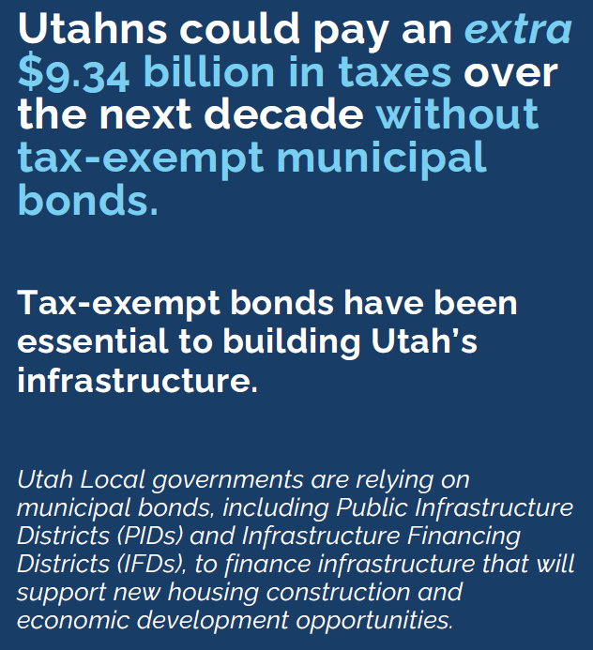
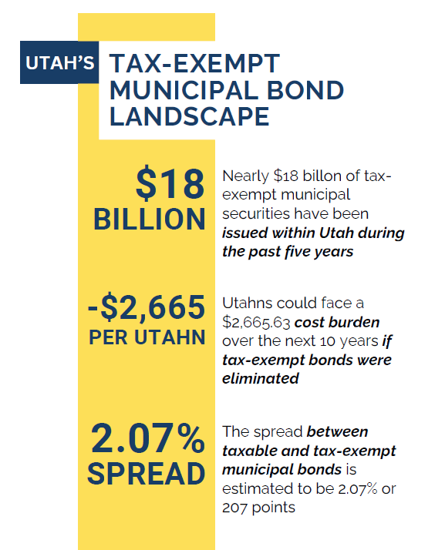
Notes:
House Ways and Means Committee had municipal bond exemption on a list for potential cuts in February. At least one GOP member on committee is reportedly fighting to keep them.

