Slide 1
Artificial Intelligence…
…And Local Government Finance
Notes:
Mention interviewees and who they were

Slide 2
Agenda
Understanding Artificial Intelligence and its Implications
Exploring AI Typology: Traditional vs. Generative
Evaluating AI Opportunities
Distinguishing Point Solutions from Systems Solutions
Public Finance Applications

Slide 3
Very Basic AI Typology
Traditional AI/ML: Pattern recognition, classification, and prediction.
Generative AI: Creates new text, images, or data based on patterns in existing data.

Slide 4
Generative AI Models
Foundational
(Generalist)
Specialized

Slide 5
Different Foundational Models have Different Strengths
(For now)
Reasoning
Speed
Writing
Multimodal

Slide 6
Many of the Basics of AI are Not New. So, what is?
Big data
Dramatically lower cost of compute
Improvements in algorithms
Transformer architecture and scaling
Notes:
The Transformer architecture is arguably the most important breakthrough because it made it possible to scale AI models to handle massive datasets efficiently and understand complex, nuanced language patterns. he Transformer’s key innovation is the self-attention mechanism, which allows models to focus on different parts of the input text (or sequence) simultaneously, rather than processing it sequentially (as older models like RNNs did). This drastically improved how models could learn the relationships between words over long distances in a sentence, capturing context more effectively.

Slide 7
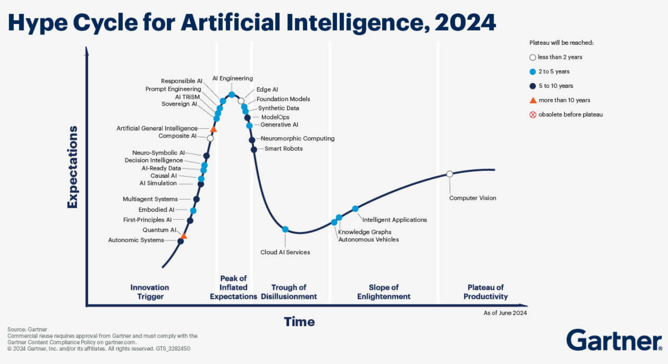

Slide 8
The AI Theme for 2025?
Agentic (Agent-based) AI

Slide 9
AI as an Agent: From Tools to Autonomous Action
AI systems designed actively pursue goals, make decisions, and operate with some autonomy.
An AI Agent typically:
Sets goals (based on a human-provided objective).
Plans a sequence of actions to achieve goals.
Acts autonomously within defined rules or boundaries.
Learns and adjusts from feedback and outcomes.

Slide 10
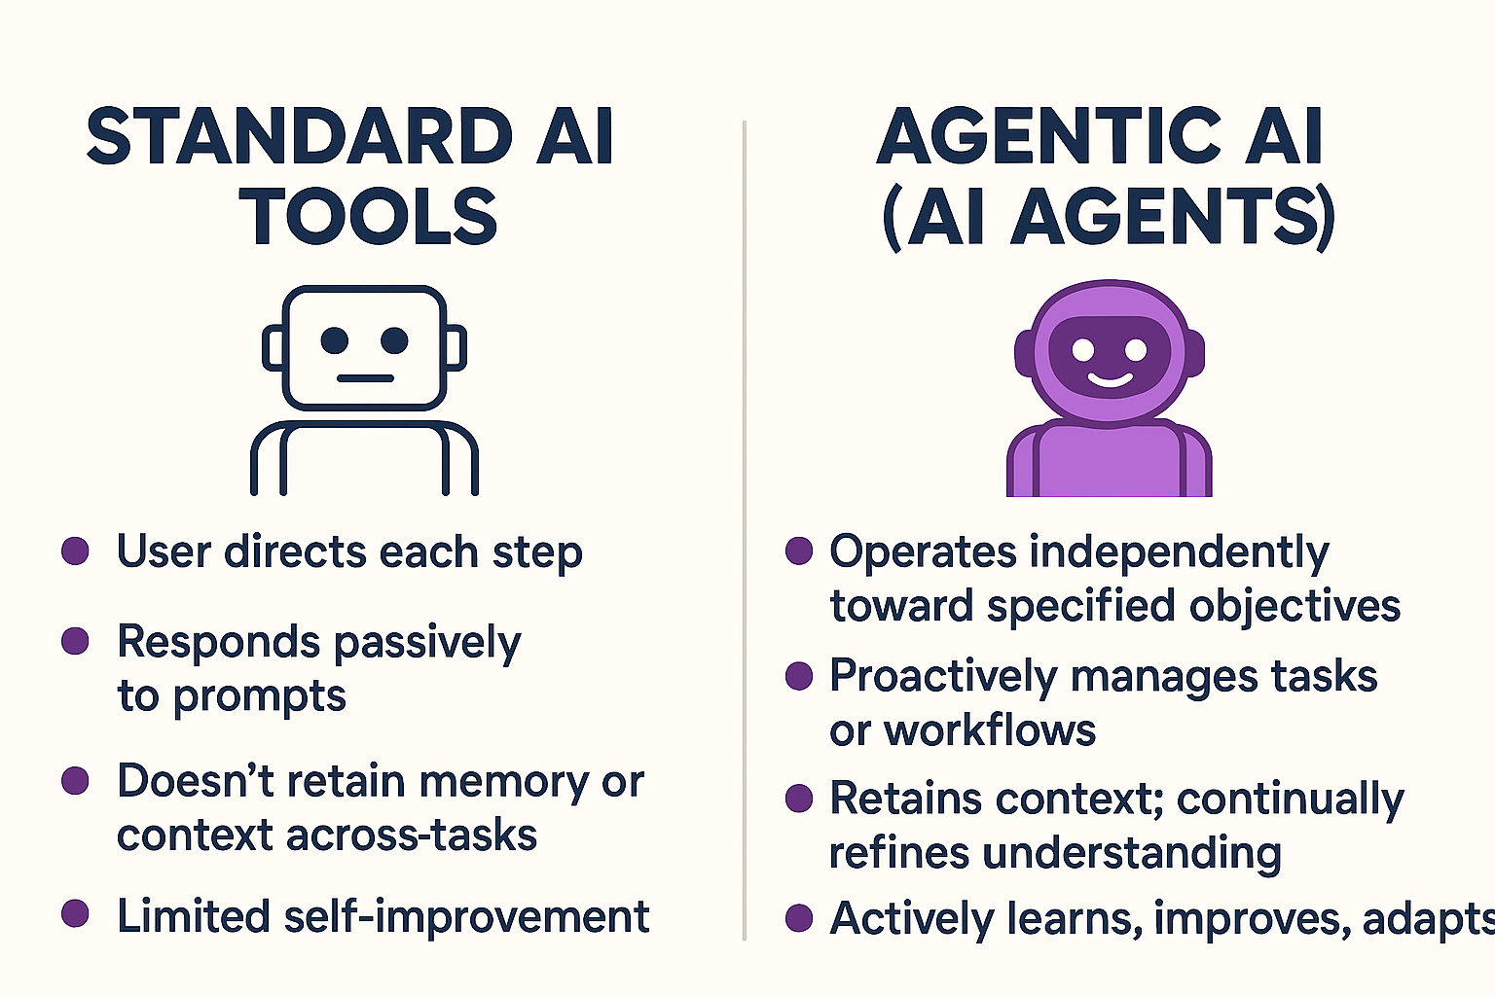

Slide 11
What Could Agentic AI Look Like in Government Finance?
Automated Financial Auditing Agent | Budget Management and Alert Agent
Goal: Identify anomalies and risks in financial transactions. | Goal: Maintain balanced budget goals.
Action: Continuously monitor transactions, investigate irregularities, provide alerts, suggest corrective actions | Action: Autonomously monitor budget expenditures, predict shortfalls, proactively alert managers, recommend reallocations.

Slide 12
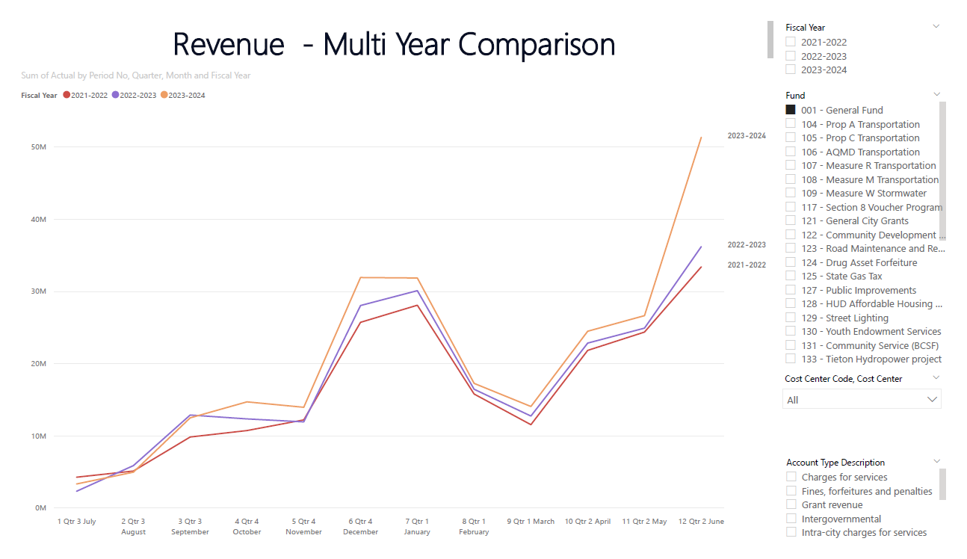

Trend Analysis of Revenues – Comparison to prior years
Show trend of the revenue for each month for three fiscal years

Slide 13
How is Agentic AI Different from Robotic Process Automation
Aspect | RPA (Robotic Process Automation) | Agentic AI
Core Capability | Executes pre-defined rules and procedures precisely and repeatedly. | Autonomously plans and adapts based on goals, predictions, and changing circumstance.
Adaptability | Low: Works only within defined processes; struggles with exceptions or ambiguous cases. | High: Adapts behavior based on feedback, learning, and environmental changes.
Decision-making | Does not make decisions; automates decisions humans pre-programmed. | Makes decisions autonomously, leveraging AI-driven predictions and reasoning.
Learning & Improvement | Typically does not learn or improve from past outcomes; improvement requires manual reprogramming. | Actively learns from experience and feedback, automatically improving performance over time.
Scope of Application | Highly repetitive, standardized tasks (e.g., data entry, reconciliation, copying between systems). | Complex, ambiguous, or dynamic tasks (e.g., anomaly detection, scenario planning, adaptive forecasting, predictive maintenance).

Slide 14
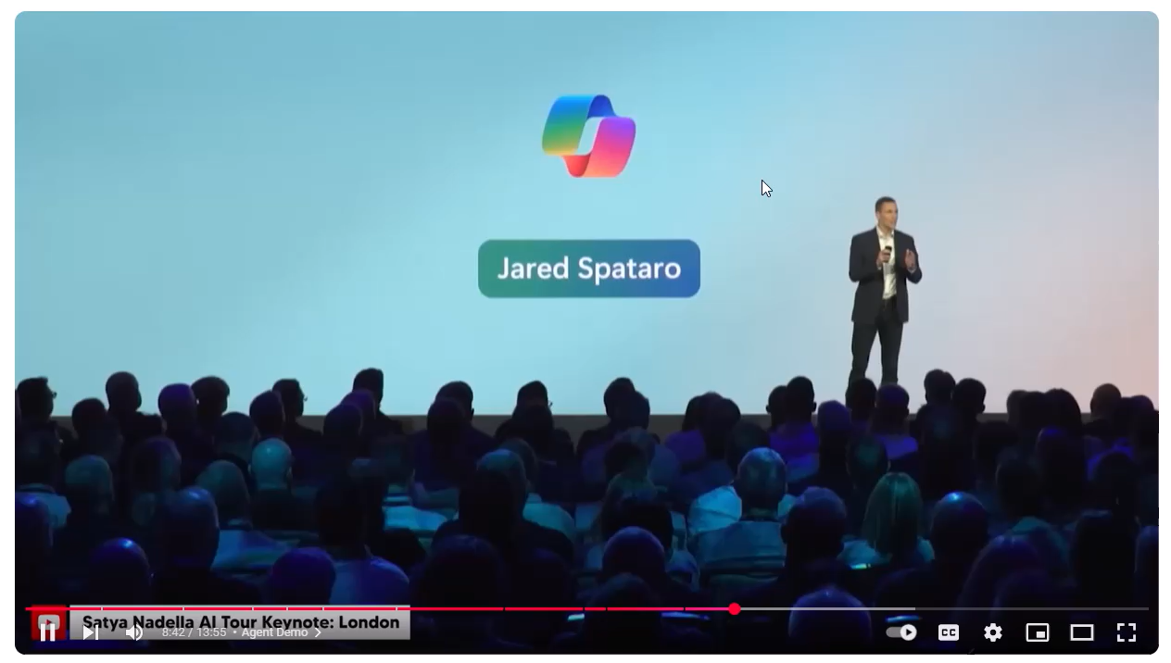

Slide 15
Framework for Evaluating AI Opportunities

Slide 16
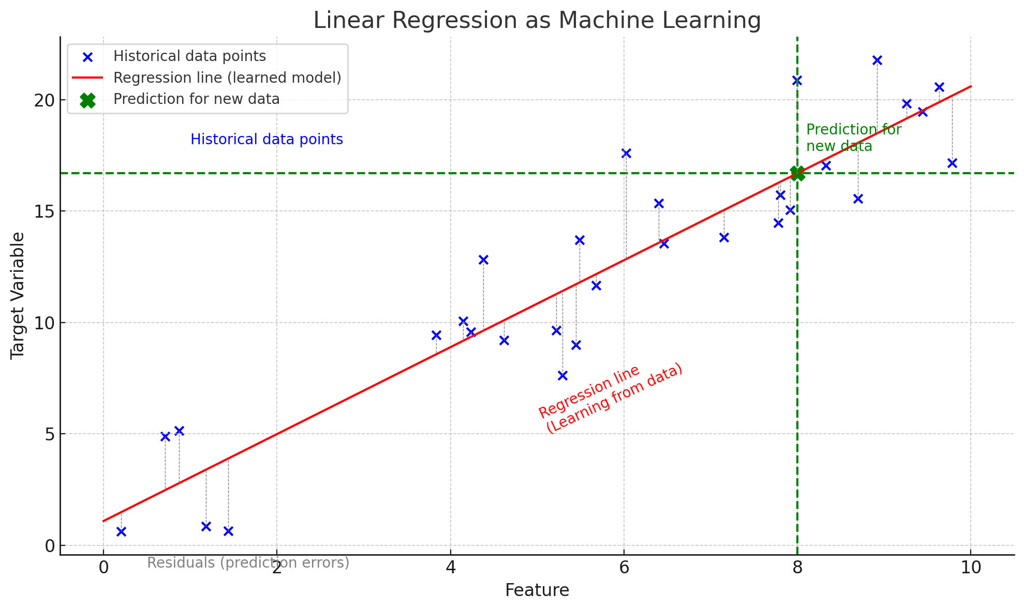
Understand what “AI” Solutions Include…

Slide 17
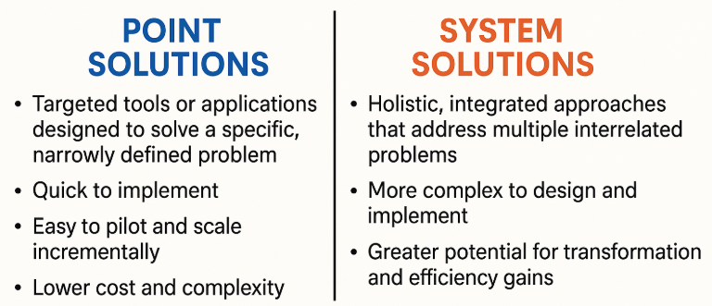

Slide 18
Point Solution*
AI of limited scope that involves little to no change in the underlying decision architecture.
Producing a summary of meetings
Making revenue forecasts
Producing graphics for reports
Summarizing larger reports into shorter reports
What point solutions have you had success with?
*Concept from: Power and Prediction: The Disruptive Economics of Artificial Intelligence by Ajay Agrawal, Joshua Gans, Avi Goldfarb

Slide 19
Systems Solutions
Embraces what AI is: advanced statistical prediction. Identity where better predictions would be helpful, make predictions with AI, and decide accordingly. Requires changing your decision architecture.
Financial Monitoring and Risk Management
Smart infrastructure maintenance
Personalized pricing for fees
Forecasting

Slide 20

Lessons from GFOA ACFR Award Application Intake
Use AI to predict if applications “pass”
Think about relative risk
Remember the
Beat the Bear Fallacy

Slide 21


Slide 22


Slide 23


Slide 24


Slide 25
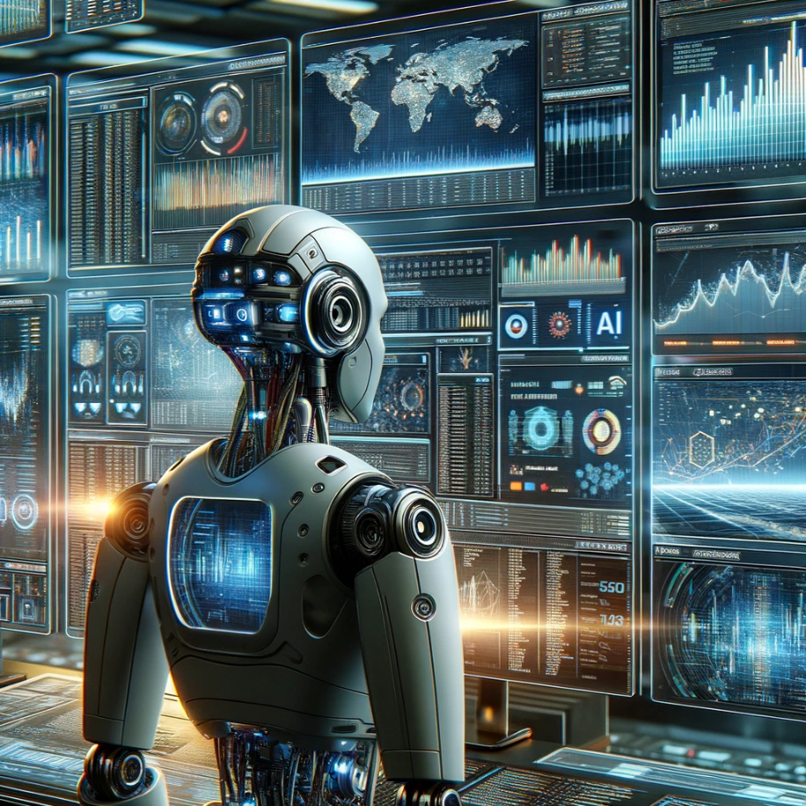
Financial Monitoring and Risk Management
Automated anomaly detection
AI-assisted Audit and Compliance Checks
Automated Budget Monitoring and Alerts
Cash Flow Optimization
Notes:
AI can enhance fraud detection in local government by analyzing patterns and anomalies in financial transactions and procurement processes, enabling early identification of irregular activities that may indicate fraud. Through machine learning algorithms, AI systems learn from historical data to pinpoint fraudulent behavior with high accuracy, reducing false positives and improving the efficiency of investigations. Additionally, AI-driven tools can continuously monitor vast amounts of data across different departments and platforms, ensuring comprehensive oversight and strengthening the integrity of financial operations within local governments.

Slide 26
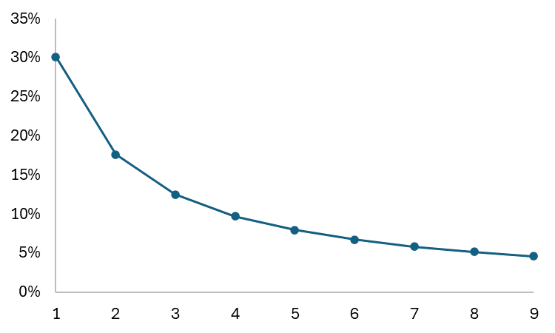
Benford’s Law
Frequency of leading digits in many real-life sets of numerical data.
The leading digit is more likely to be small
If the digits in financial documents deviate much from Benford's Law, it may suggest manipulation or falsification of data.
Notes:
Imagine the city government's analysis of its vendor payments over the past year reveals a significant deviation from Benford's Law, with an unusually high frequency of payments beginning with the digit 9. This anomaly triggers a closer examination of those transactions, leading to the discovery that a series of contracts were awarded at inflated prices to a single vendor. Further investigation uncovers a collusion scheme between a city official and the vendor to overcharge the city for services, resulting in fraudulent overpayments.

Slide 27
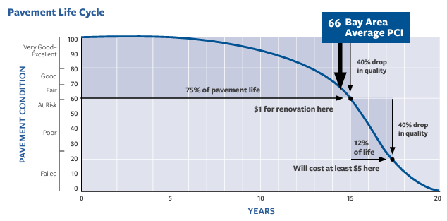
Infrastructure Maintenance
Notes:
predictive analytics can forecast potential breakdowns and optimize repair schedules, reducing downtime and extending the lifespan of public assets.
AI-powered monitoring systems can continuously assess the condition of infrastructure, from roads and bridges to utilities, providing actionable insights that lead to safer, more reliable public services.

Slide 28
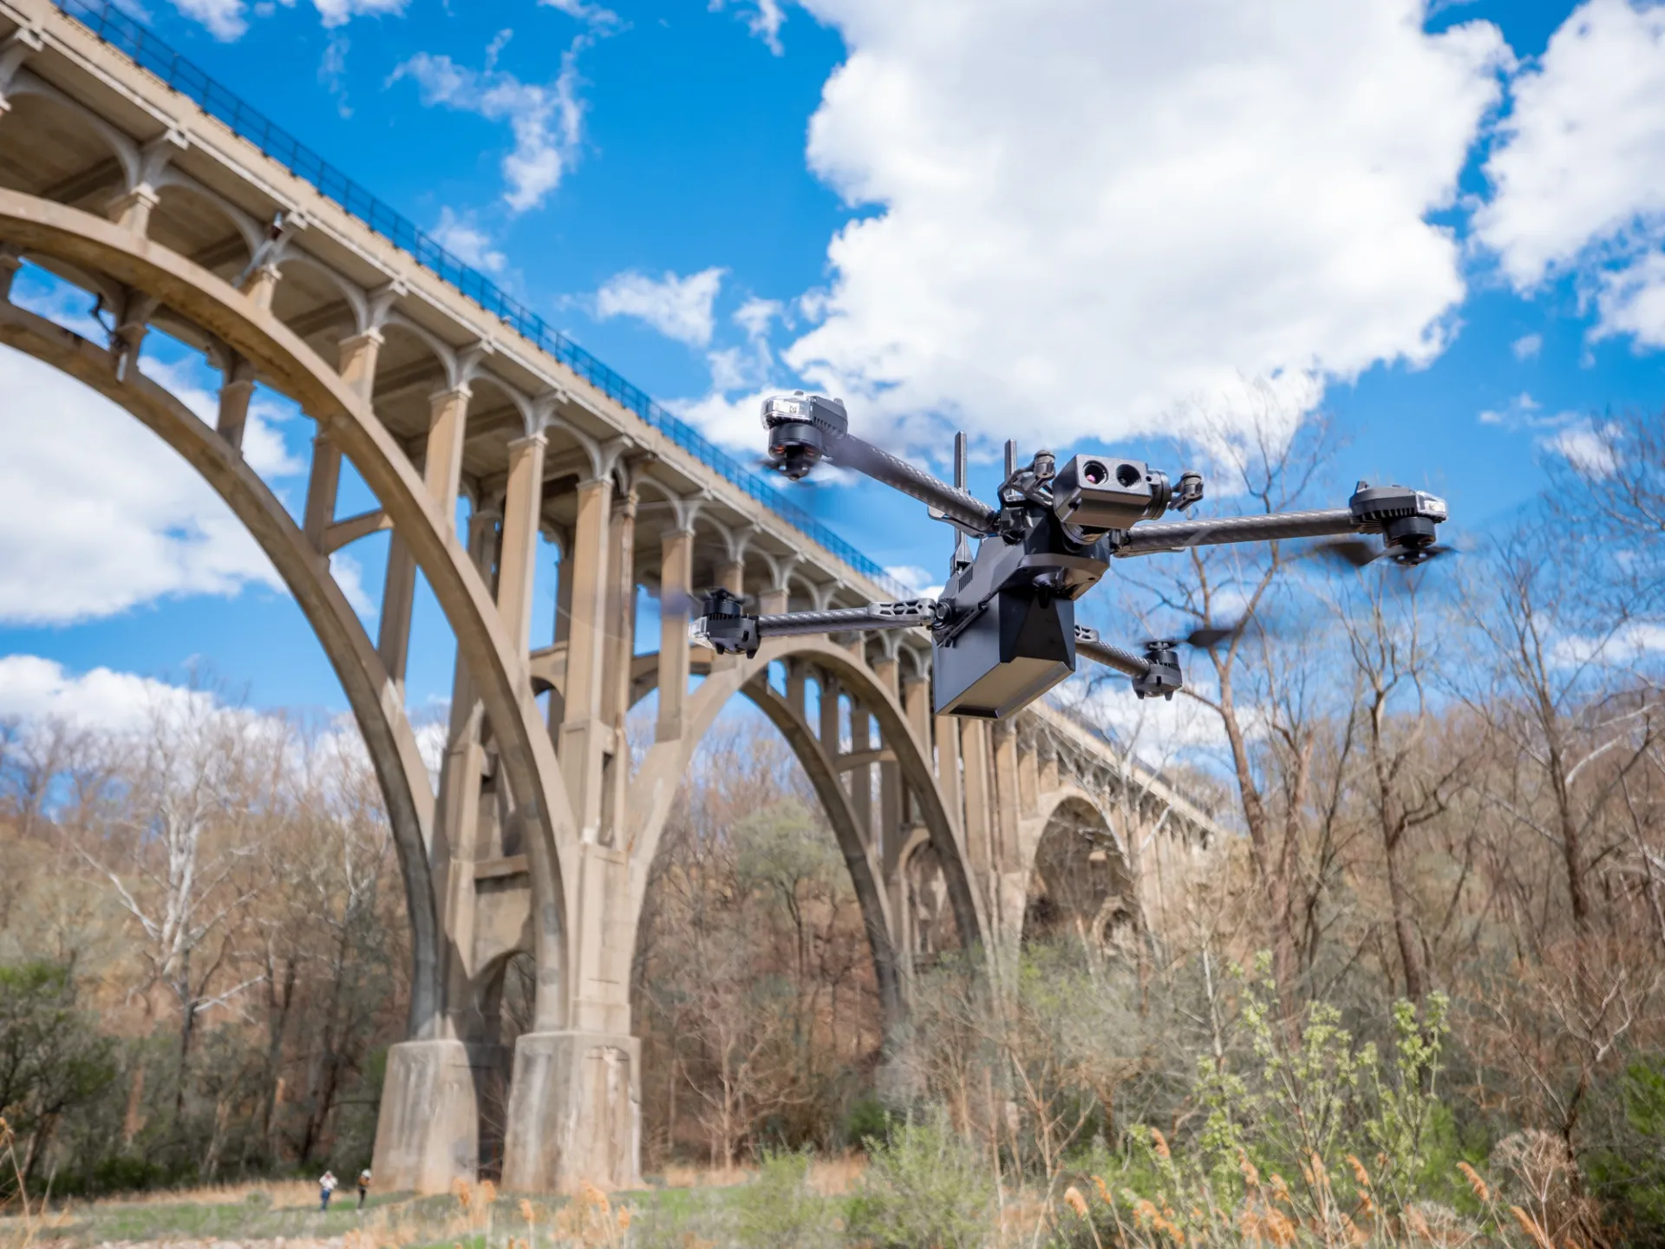
Drones are not new but what is with AI?
Computer vision to identify potential issues in structures, such as cracks or corrosion, and alert inspectors to take necessary actions.
Autonomous operation – no humans needed.
Dock-based drones and automation of entire inspection process.
Other non-drone tech could provide similar benefits (multi-sensor robots)
Notes:
predictive analytics can forecast potential breakdowns and optimize repair schedules, reducing downtime and extending the lifespan of public assets. AI-powered monitoring systems can continuously assess the condition of infrastructure, from roads and bridges to utilities, providing actionable insights that lead to safer, more reliable public services.

Slide 29
Why is Infrastructure a Good Example?
Based on more mature AI technology (computer vision)
Clear predictive question – where are we on the deterioration curve?
Clear payoff to answer – intervene before hitting the steep part of the curve

Slide 30
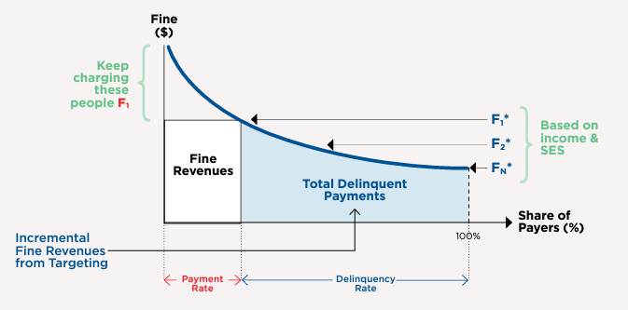
Smart Pricing

Slide 31
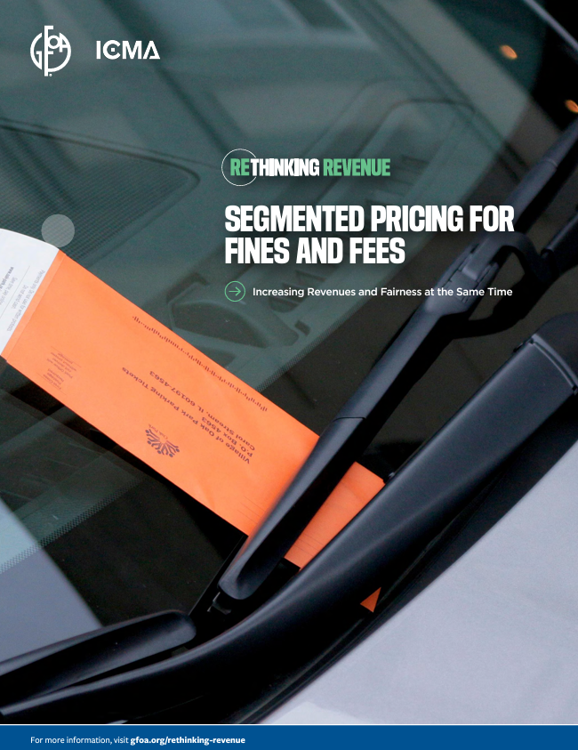

Smart Pricing
Use machine learning to estimate customer ability to pay and adjust prices accordingly. A bit like credit scoring.
Smart pricing already in use by many private sector companies.
GFOA participating in pilot program for water bills with City of Portland
Notes:
Amazon: Known for its dynamic pricing strategy, Amazon adjusts prices on its products millions of times a day based on demand, competition, stock levels, and other factors. This approach helps Amazon stay competitive and maximize sales.
Uber: The ride-sharing company uses a dynamic pricing model known as "surge pricing," which increases prices during times of high demand. This not only balances supply and demand but also encourages more drivers to be available during busy periods.
American Airlines: Like many airlines, American Airlines uses dynamic pricing to adjust fare prices in real-time based on demand, booking patterns, and market conditions. This approach helps maximize revenue per flight.
Marriott International: The hotel industry also employs dynamic pricing, with companies like Marriott adjusting room rates based on occupancy levels, booking trends, and competitive pricing, aiming to optimize revenue per available room (RevPAR).

Slide 32

Forecasting
Improved accuracy
  Better use of time series
  Incorporate external data
Scenario analysis
Supercharge forecast usefulness

Slide 33
Forecasting
Algorithms can analyze historical financial data, economic indicators, and other information to forecast revenues and expenses.
Automated forecast software has been around a while. According to GFOA tests, it outperforms manual forecasts.
AI could automate selection of techniques and other parameters that had to be performed by humans.
Notes:
Feature Engineering and Selection: AI techniques can automatically identify and select the most relevant features (variables) that impact the forecast. This can include both internal data (like historical sales) and external factors (like economic indicators, weather conditions, and social trends), enhancing the model's predictive capabilities.
Anomaly Detection: AI can help in identifying outliers or anomalies in the data that may distort the forecasting model. By detecting and appropriately handling these anomalies, the system can produce more reliable forecasts.

Slide 34
So, what’s the best use of AI in Public Finance?
What data should you be concerned about?
Remember that AI is a prediction machine
What questions in budgeting do you want better predictions for? And are you willing to use the predictions to make better decisions?

Slide 35
“The value of information that doesn’t change a decision is zero”
-Richard Zeckhauser, Economist

Slide 36
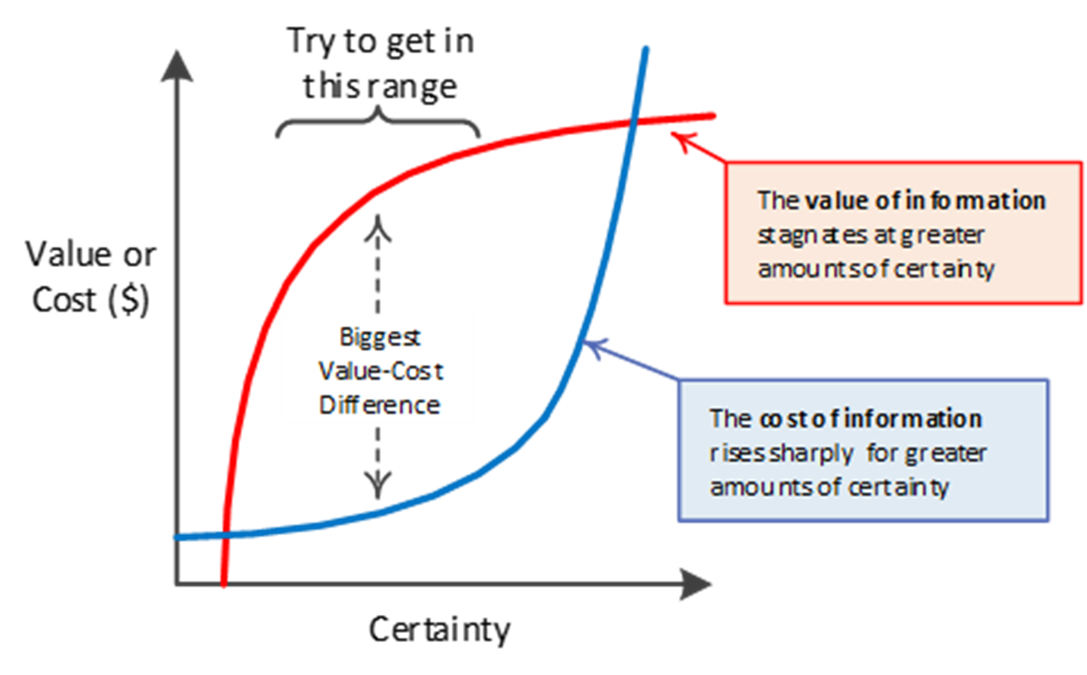
The Value of Information

Slide 37
What Issue in Your Government Do You Think Could Most Benefit from Better Predictions?
Where is there low certainty about the state of world AND…
Where would people make different decisions based on AI predictions?
Step 1 - 1 minute silent contemplation | Step 2- 2 minutes to talk with a partner
Step 3- 4 minutes to talk with in group of four | Step 4 - Share thoughts from groups

Slide 38
The End
Connect on LinkedIn - Shayne Kavanagh at GFOA
And I can always be reached at skavanagh@gfoa.org
Notes:
Which use case might work for you?

